Slide 1

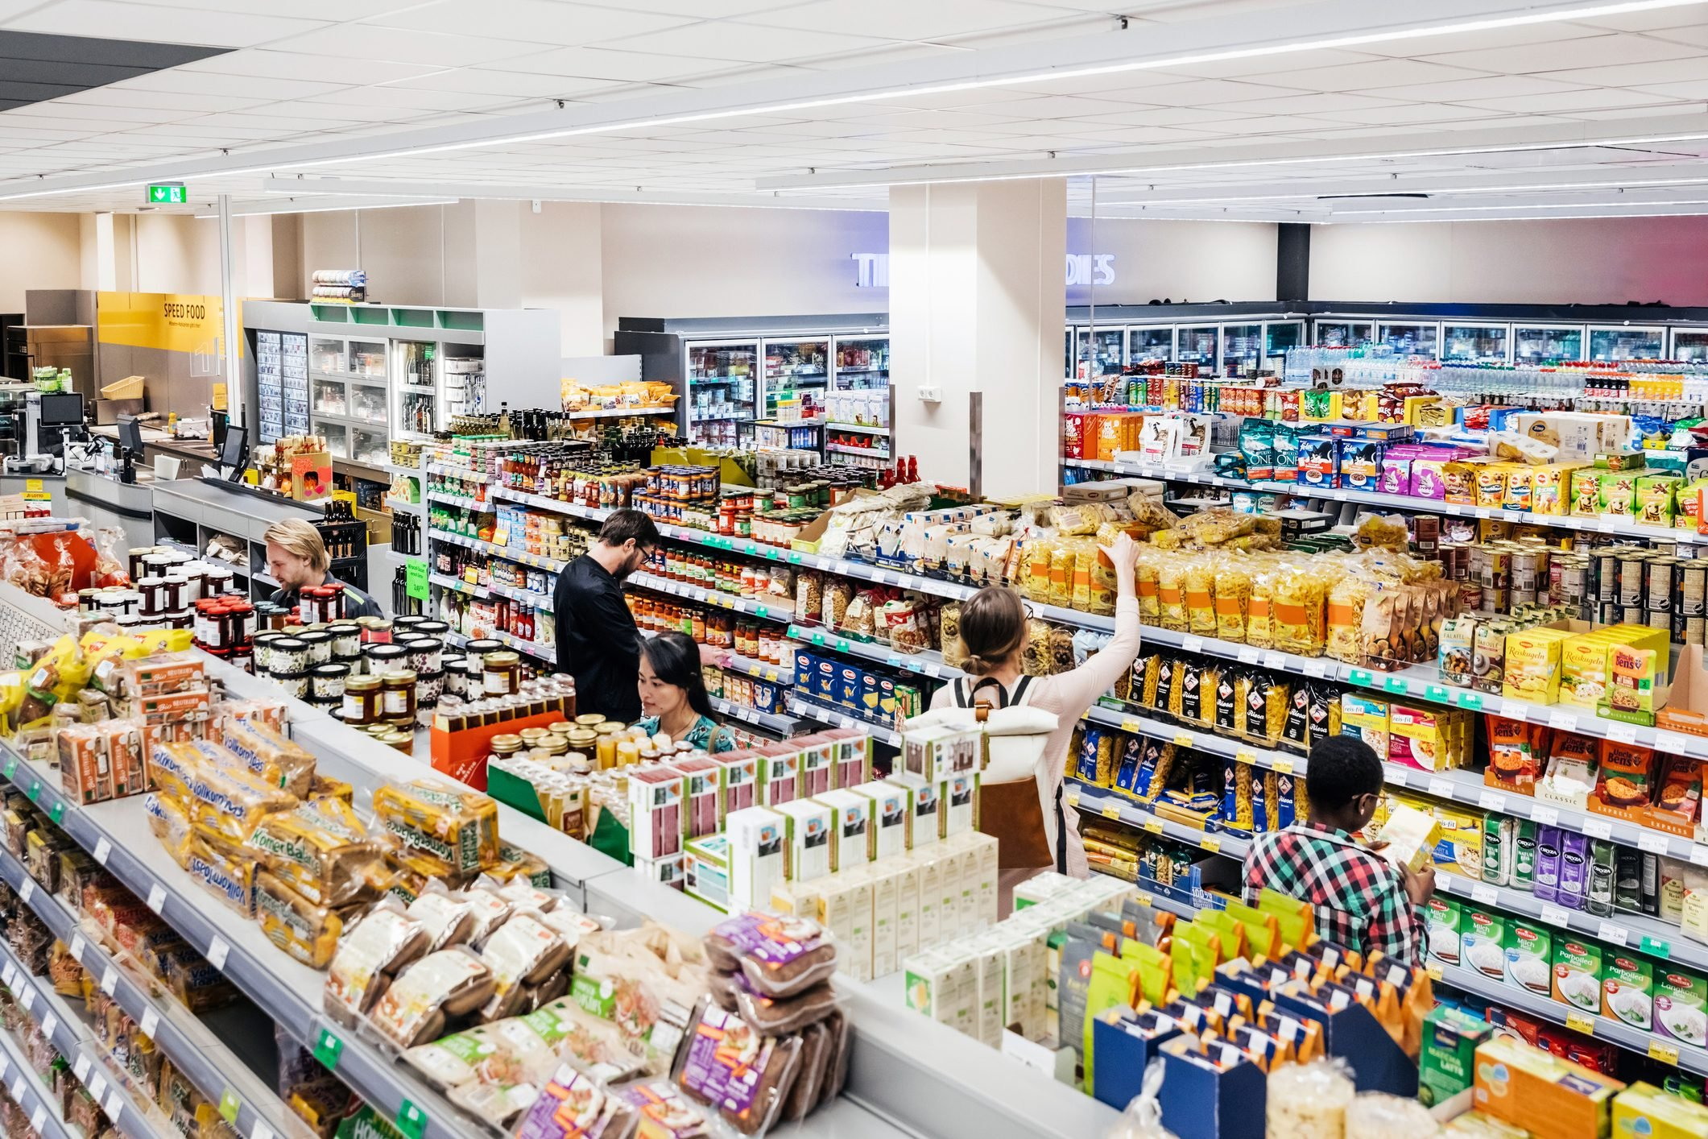
Marketing Retail Analytics
Bhushan Rai
Great Learning PGDSBA2002-203

Slide 2
Contents:
:Exploratory Analysis --> Exploratory Analysis of data & an executive summary,,
Trends across months/years/quarters/days
Use of Market Basket Analysis (Association Rules)
KNIME workflow image
Threshold values of Support and Confidence
Associations Identified -confidence, & lift values
Suggested Possible Combos and Lucrative Offers

Slide 3
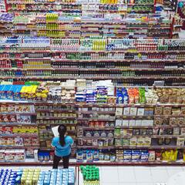
Business Problem:
A grocery store shared the transactional data with you. Your job is to conduct a thorough analysis of Point of Sale (POS) data, identify the most commonly occurring sets of items in the customer orders, and provide recommendations through which a grocery store can increase its revenue by popular combo offers & discounts for customers
Data Dictionary:
Date, Order ID, Product

Slide 4
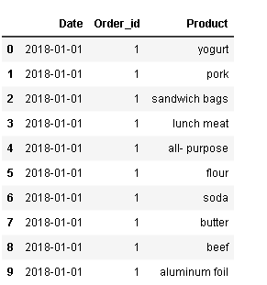
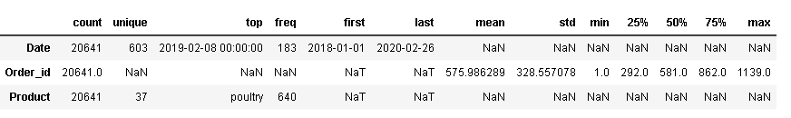
# The dataset has 20641 rows and 3 columns 37 unique product categories. #The most frequently occurring product category poultry appearing 640 times. #It seems that there are missing statistics (mean, std, min, 25%, 50%, 75%, max) for the Product column
Sample of the dataset and description of the data
s

Slide 5
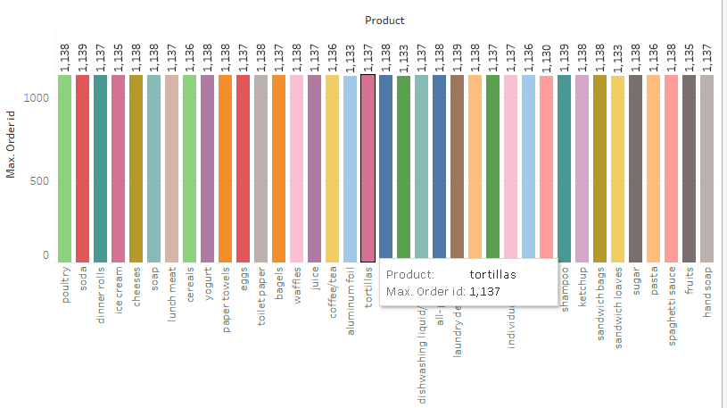

Slide 6
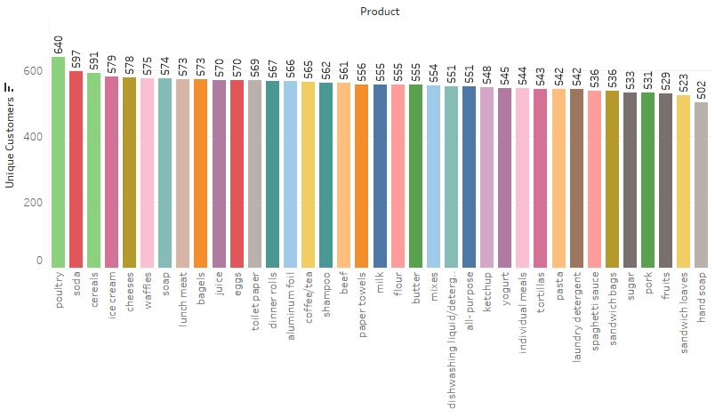

Slide 7
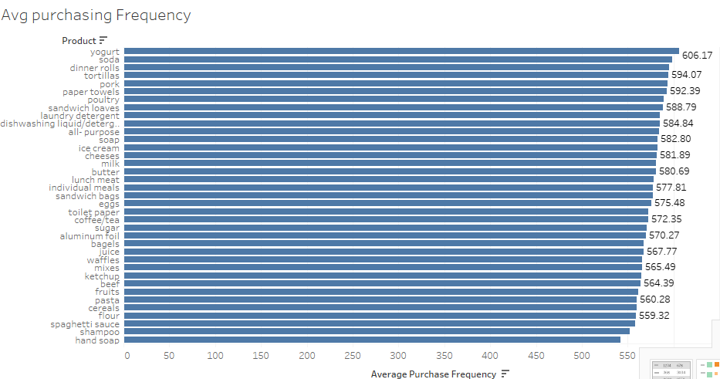

Slide 8
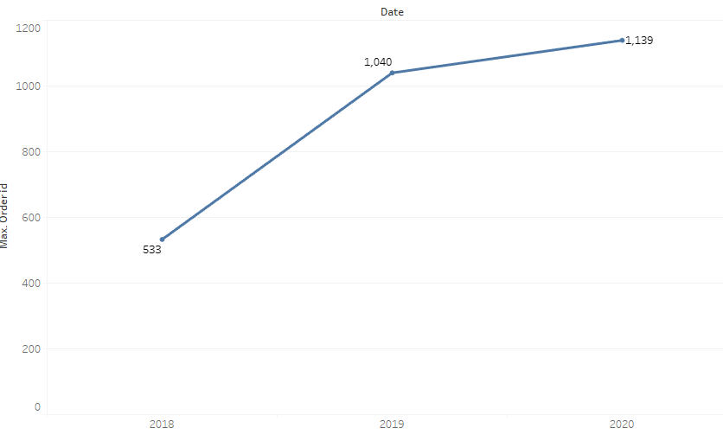

Slide 9
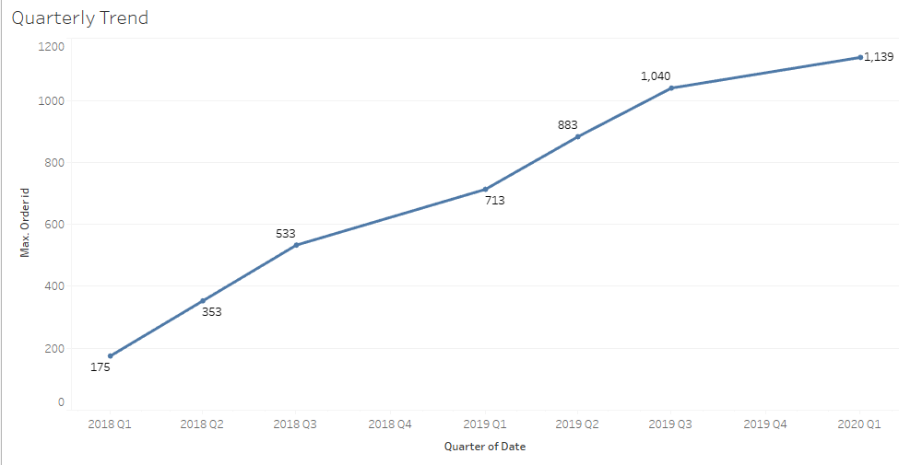

Slide 10
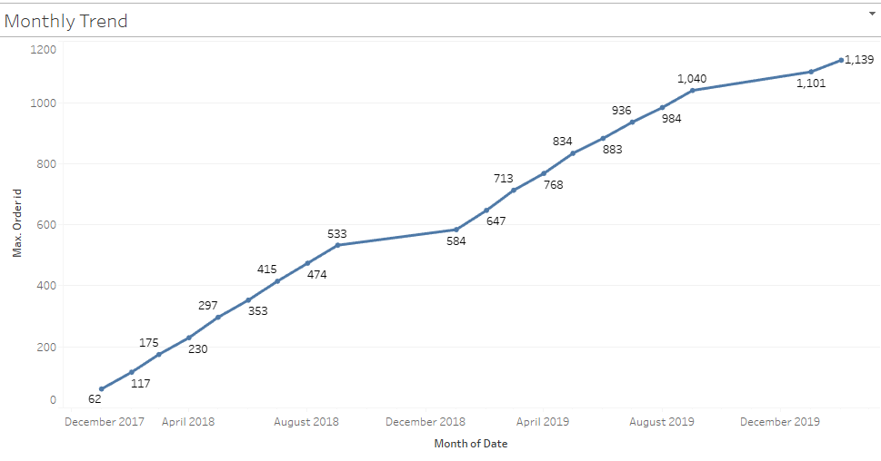

Slide 11
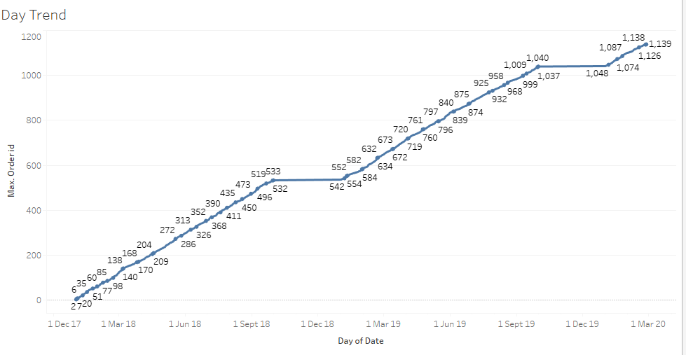

Slide 12
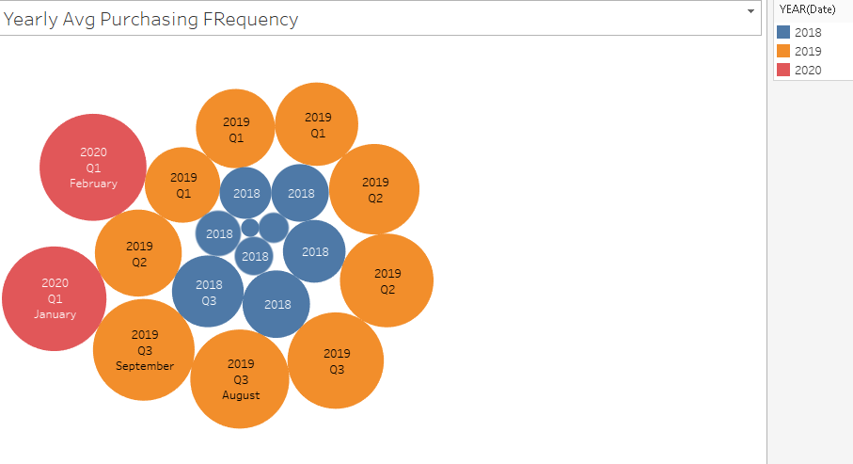

Slide 13
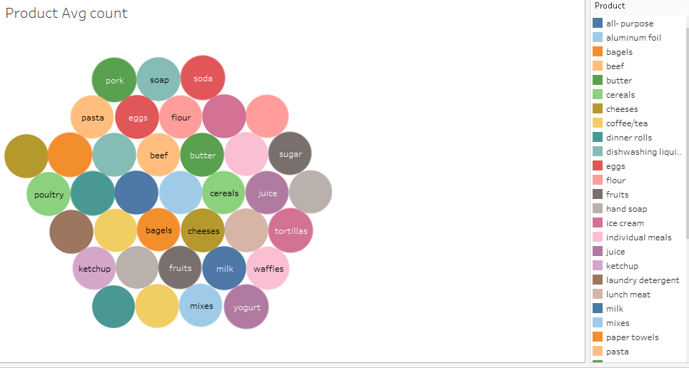

Slide 14
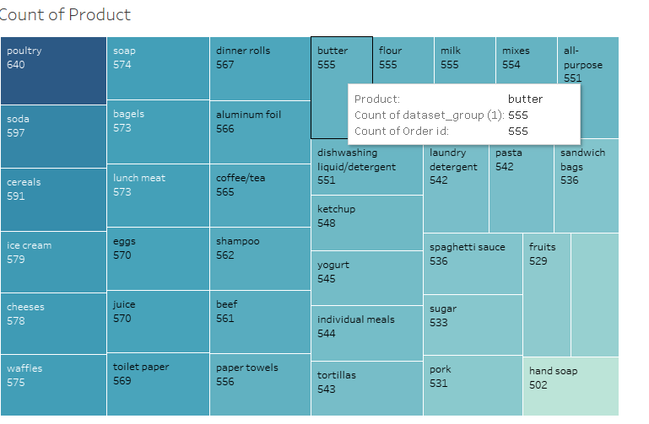

Slide 15
Products yogurt, soda, dinner rolls, tortillas, pork, paper-towels, poultry, sandwich loaves, laundry detergent, liquid detergent has the highest frequency(top 10)
Data shows raise in orders in consecutive years 2018,2019,2020
Quarterly Trend also shows a significant raise in orders
Monthly and daily trends has a significant break up of the orders

Slide 16
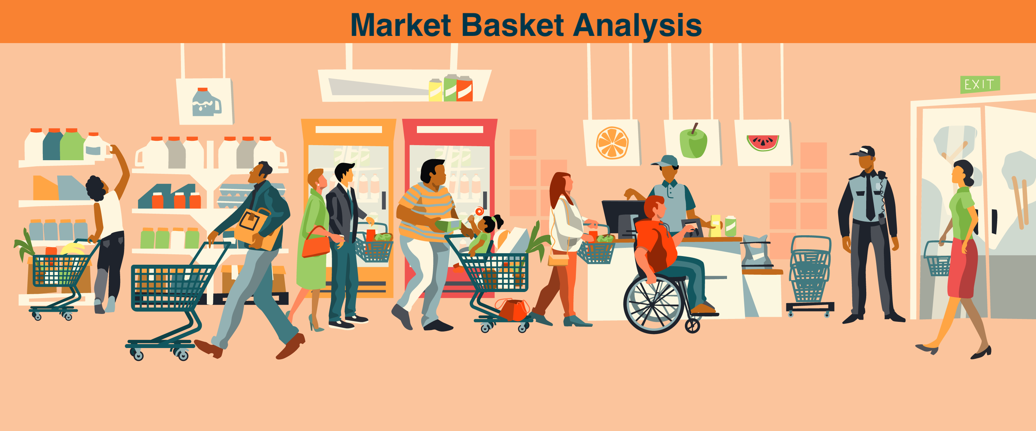
Market basket analysis is a data mining technique used in the field of retail and business analytics to discover patterns, associations, and relationships within transactional data. Its primary objective is to identify which items are frequently purchased together by customers

Slide 17
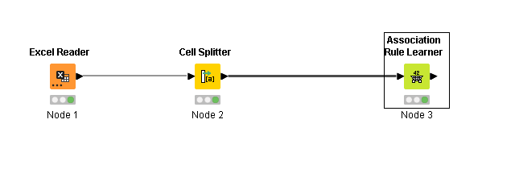

Slide 18
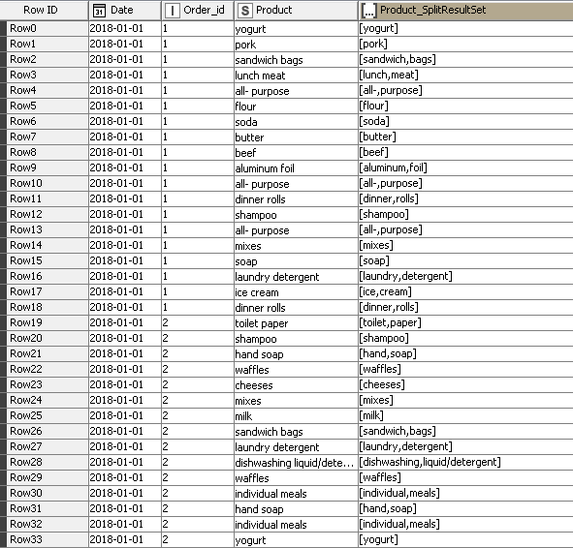

Slide 19
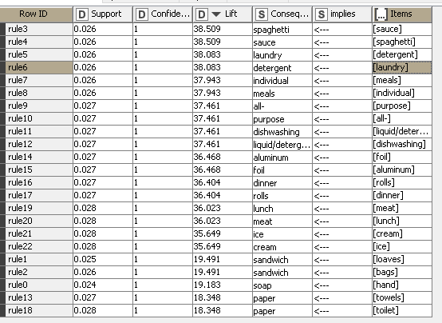
Identified Associations:

Slide 20
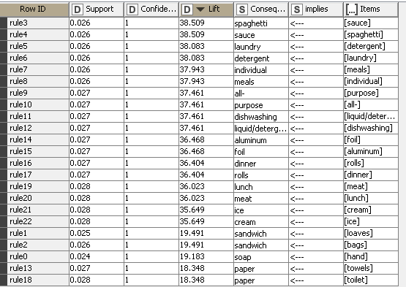
In total of 22 rules found in the dataset , A lift value greater than 1 suggests a positive association. A confidence of 1.0 means that the antecedent is always bought when the consequent is purchased. Support measures the frequency of occurrence of both items together. It is a proportion of transactions that contain both items.
The items on both sides of the "<---" arrow are the antecedent and consequent of the association rule, indicating which items tend to be purchased together.

Slide 21
Based on these association rules here are some potential recommendations based on the provided rules:
Spaghetti & Sauce: Since spaghetti and sauce have a high lift and confidence, you can recommend placing them together in-store or running promotions like "Buy Spaghetti, Get Sauce at a Discount."
Laundry & Detergent: Given the strong association between laundry and detergent, you could consider bundling these products or offering detergent discounts to laundry product purchasers.
Individual Meals: If individual meals and meals are frequently bought together, you might create meal combos for customers looking for quick meal solutions.
All-Purpose & Dishwashing Liquid/Detergent: Encourage customers to purchase both all-purpose and liquid dishwashing detergent together, perhaps by offering a discount on the combination.
Aluminum Foil: Since aluminum and foil have a strong association, consider placing them together in-store or running promotions on foil for customers buying aluminum products.

Slide 22
Dinner Rolls: Promote dinner rolls alongside dinner items, especially during dinner hours or special meal occasions.
Lunch & Meat: If lunch and meat are frequently bought together, create lunch kits or promotions that include meat options.
Ice Cream: Since ice and cream have a high lift, you could promote ice cream during the purchase of ice products, especially during warm weather.
Sandwich & Bags: Encourage the purchase of sandwich bags when customers buy sandwich ingredients.
Soap & Hand: Place hand soap and soap products together in-store for convenience.
Paper Towels & Toilet Paper: Consider bundling paper towel and toilet paper products or running promotions for customers buying one when purchasing the other.
These recommendations are based on the associations observed in the dataset and can be used to optimize product placement, marketing campaigns, and pricing strategies to increase sales and customer satisfaction.

Slide 23


